Slide 1
Spring 2022 - PHYCS426
INVESTIGATING MAGNETISM WITH THE ISING MODEL
Instructor
Dr. Jawad Mohammed Taher Alsaie
Authors
Asif Bin Ayub 20191251
Kumail Abdulaziz 20196080

Slide 2

TABLE OF CONTENTS
Introduction
↑
Magnetic Properties
↑
↑
Results & Discussion
↑
Future Work & Summary
↑
2

Slide 3
INTRODUCTION
The Enduring Mystery of Magnets
↑
Types of Magnetisms
↑
↑
The Ising Model
↑
Monte Carlo Metropolis Method
↑
3

Slide 4


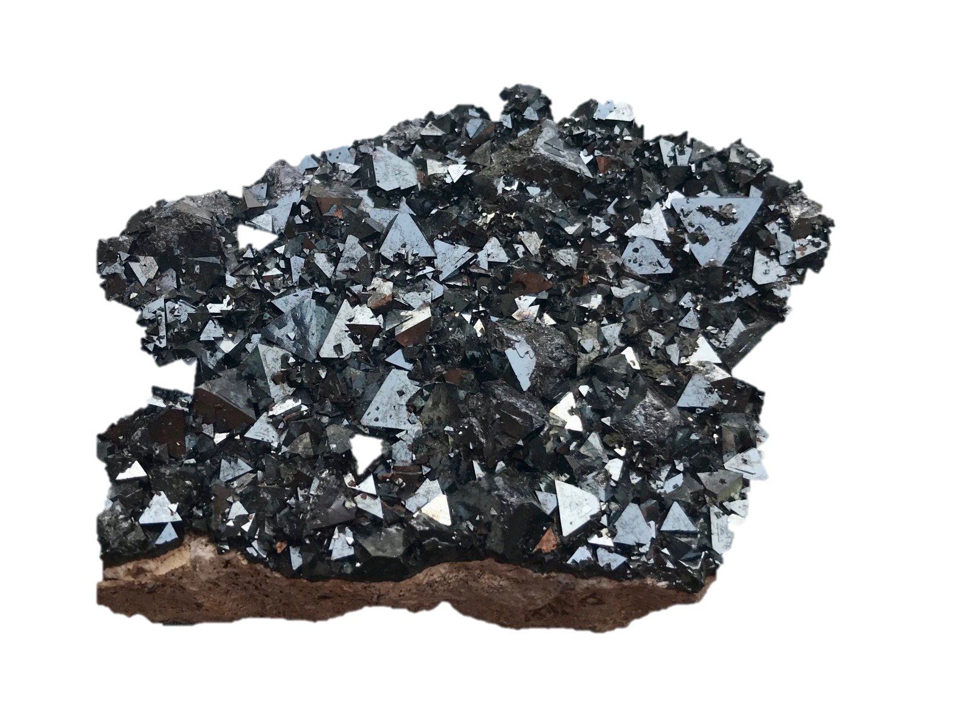
The Enduring Mystery of Magnets
How do magnets work?
It turns out we need quantum mechanics to fully explain it.
Ancient Greeks found that certain stones attracted pieces of iron.
In fact, the word “magnet” comes from the Greek region of Magnesia, where these stones were observed.
↑
↑
↑
↑
↑
4

Slide 5
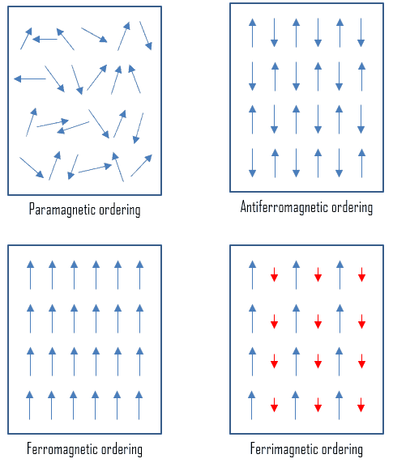
Types of Magnetisms
Paramagnetic Materials:
Composed of atoms/ions that have a permanent atomic dipole.
Aligns in the direction of external magnetic field. No permanent magnetization without external field.
Susceptibility X is small and greater than 0.
↑
↑
↑
↑
↑
↑

Slide 6
↑
Ferromagnetic Materials:
Possess a permanent magnetization (via domains), even in the absence of external field.
Strongly aligns with external magnetic field.
Possess very large positive susceptibility.
Characterized by a critical Temperature called Curie Temperature above which they exhibit paramagnetism.
↑
↑
↑
↑
↑
↑
↑

Slide 7
↑
Anti-ferromagnetic Materials:
Unlike ferromagnets, the intrinsic magnetic moments tend to cancel each other out. (Due to neighboring unpaired electrons having opposite spins)
Characterized by the Néel temperature, above which the material exhibits paramagnetic behavior.
Usually not attracted by external field, with small susceptibility.
↑
↑
↑
↑
↑
↑
5

Slide 8
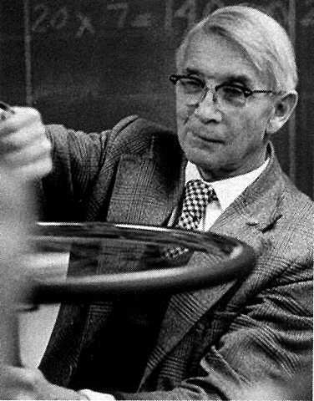
The Ising Model
The Ising model is a toy model of magnetism that simplifies the picture of magnetism at the atomic level.
It models the interaction of atoms by treating them as small magnets ("Spins") that point either up/down.
↑
↑
↑
↑
↑
↑

Slide 9
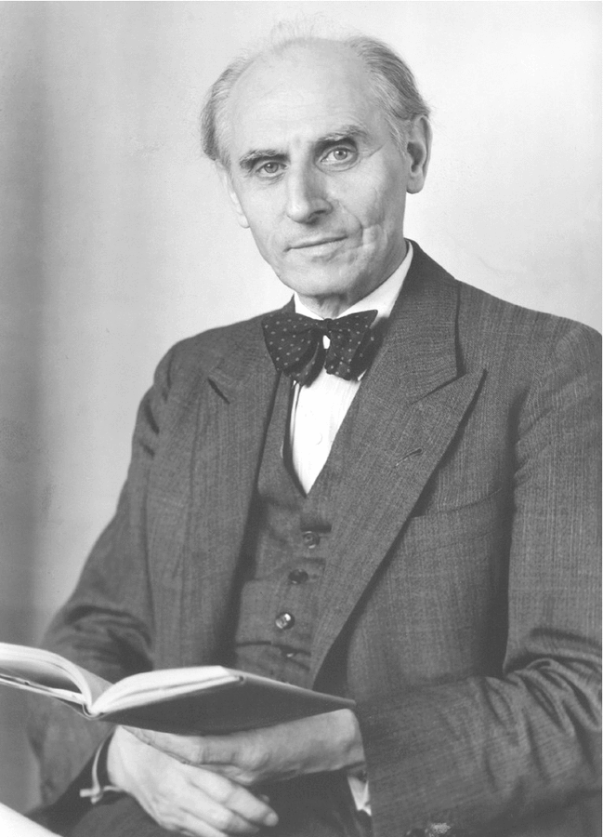
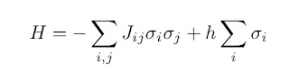
There are 2 competing "forces" at play:
1) The interaction of magnetic moments/"spins" of the atoms with each other and external magnetic field. (This tends to align them).
2) The tendency of external temperature to induce random fluctuations in the system.
↑
↑
↑
↑
↑
↑
↑
6

Slide 10
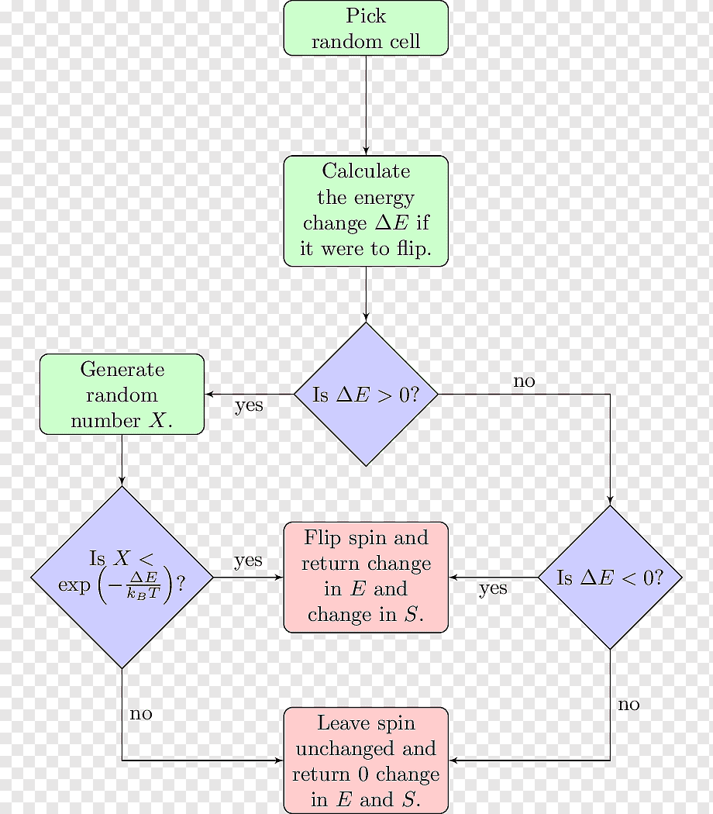
Monte Carlo Metropolis Method
Take a grid of spins and assign them an initial spin. Use periodic boundaries
Go over the grid, and decide to flip/leave the spin unchanged based on "Metropolis-Hastings" Algorithm (Figure on right)
Do the same for all spins in the grid
- Repeat this for specified "Monte Carlo Steps"
↑
↑
↑
↑
↑
7

Slide 11
MAGNETIC PROPERTIES
Magnetic Moment and Magnetization
↑
Magnetic Susceptibility
↑
↑
Curie and Néel Temperature
↑
Coercive Field
↑
8

Slide 12
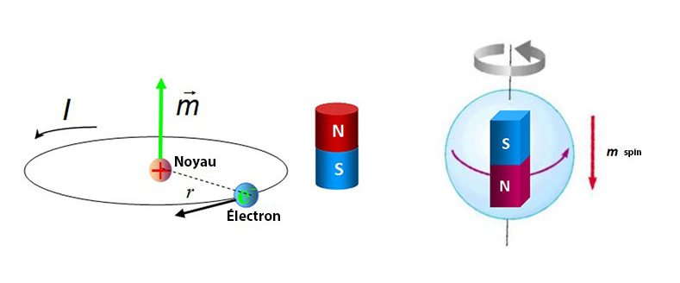

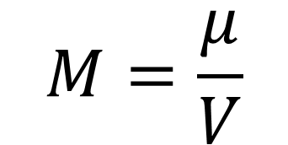
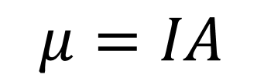
Magnetic Moment and Magnetization
Magnetic moment is a measurement of magnetic dipole strength.
Magnetization is the density of magnetic dipoles, which are induced in a magnetic material by an external magnetic field.
Different materials react differently to external field, which allows us to classify them (ferro,para etc.).
$$M=\frac{μ}{V}$$
$$μ=IA$$
↑
$$M=Σ S_{ij}$$
↑
↑
↑
↑
9

Slide 13
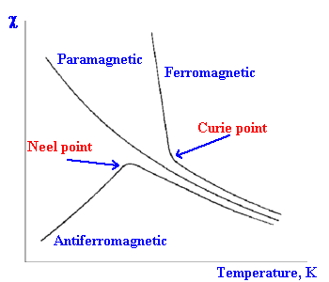
Magnetic Susceptibility
Magnetic susceptibility M=χH
Indicates the extent of magnetization in response to an external field H.
Studying Susceptibility behavior allows us to classify magnetic materials.
The sign indicates whether a substance is attracted/repelled.
Susceptibility is usually a function of the temperature and indicates nature of magnetism.
↑
↑
↑
↑
↑
10

Slide 14
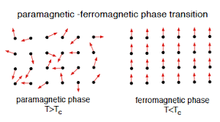
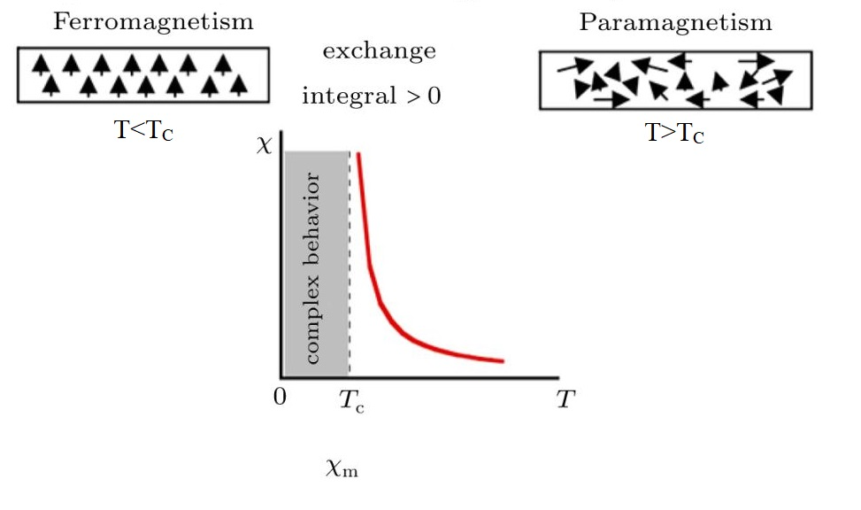
Curie Temperature (Tc)
It is the temperature at which a ferromagnetic material transitions into a Paramagnetic one.
Below Curie temperature, the material is said to have "spontaneous magnetization“
Curie Law is accompanied by first/second order phase transitions in several properties of the magnet: <M>,X & C
↑
↑
↑
↑
↑
11

Slide 15
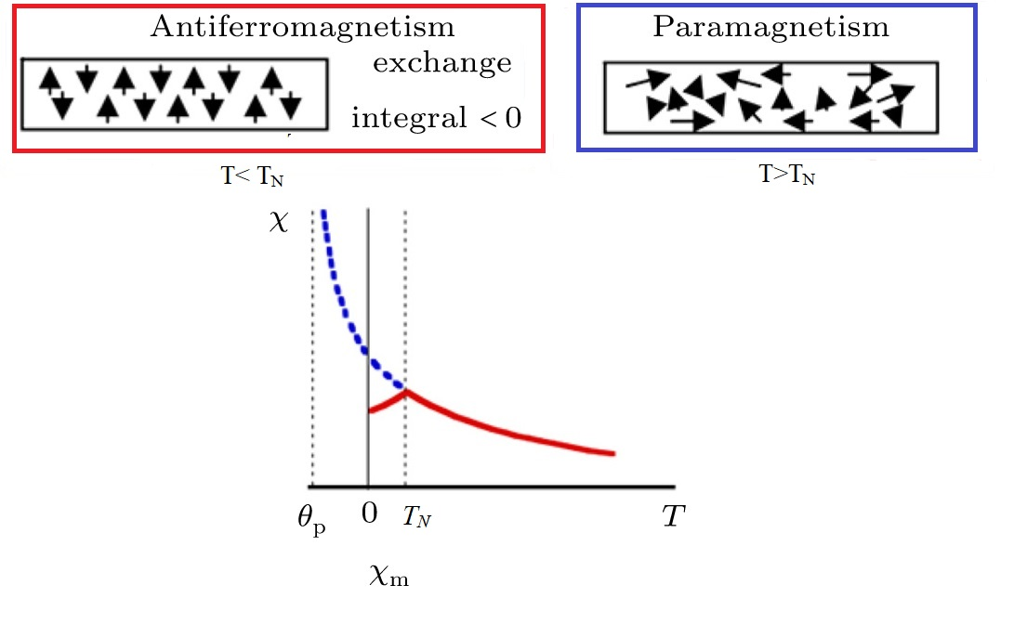
Néel Temperature (Tn)
It is the temperature at which an antiferromagnetic material transitions to paramagnetism.
At Néel temperature, the anti-parallel alignment of the material is destroyed.
Similar to Curie temperature, Néel temperature accompanies phase transitions in the magnetic properties of the substance.
↑
↑
↑
↑
↑
12

Slide 16
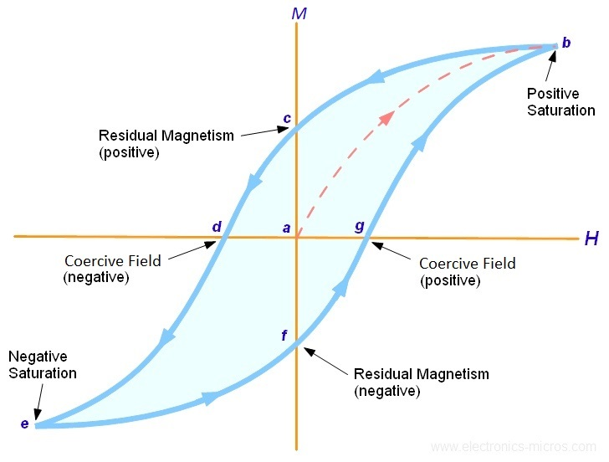
Coercive field
It is the strength of applied magnetic field (H) required to demagnetize a ferromagnetic material.
- For a permanent magnet, we want the coercive field to be large.

Slide 17
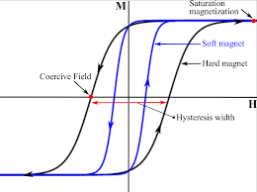
Coercivity depends on how fast we change the magnetic field (annealing time).
- The coercive field reduces as we increase the temperature, going to 0 as the material transitions to paramagnetism.
↑
↑
↑
↑
↑
13

Slide 18
RESULTS & DISCUSSION
System Size, 2D and 3D Analysis
↑
Coupling Constant Analysis
↑
↑
Anti-ferromagnetism
↑
Arbitrary Spin Direction in 2D
↑
14

Slide 19
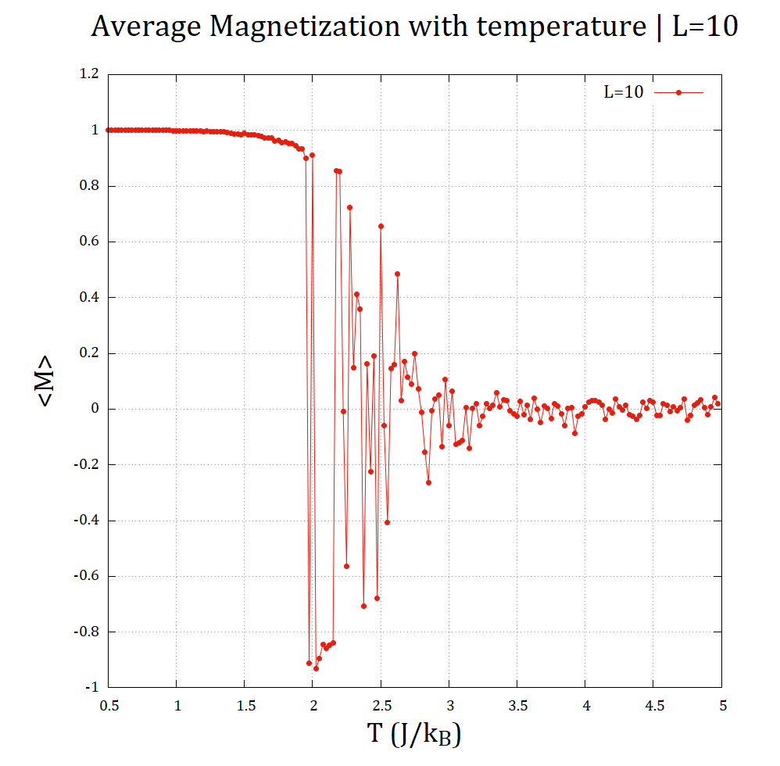
System Size and 2D Analysis
As we increase the system size the fluctuation near the Curie temperature (Tc) decreases.
That let’s get more precise value of Curie temperature (Tc).
Another way to find Curie temperature (Tc) when M goes to zero is by interpolation.

Slide 20
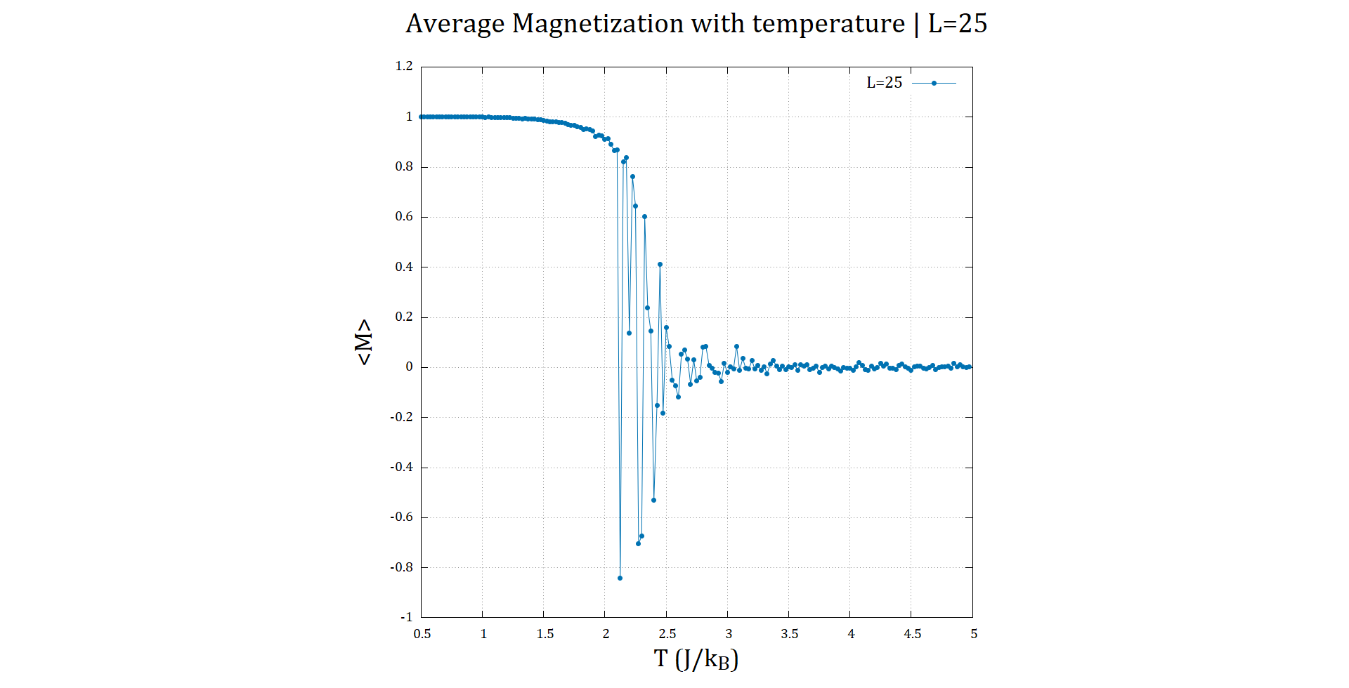
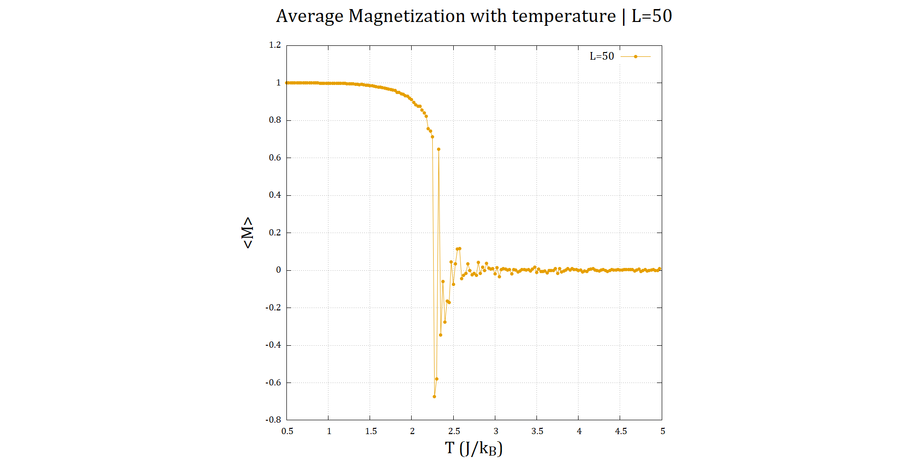
↑
↑
↑
↑
↑
15

Slide 21
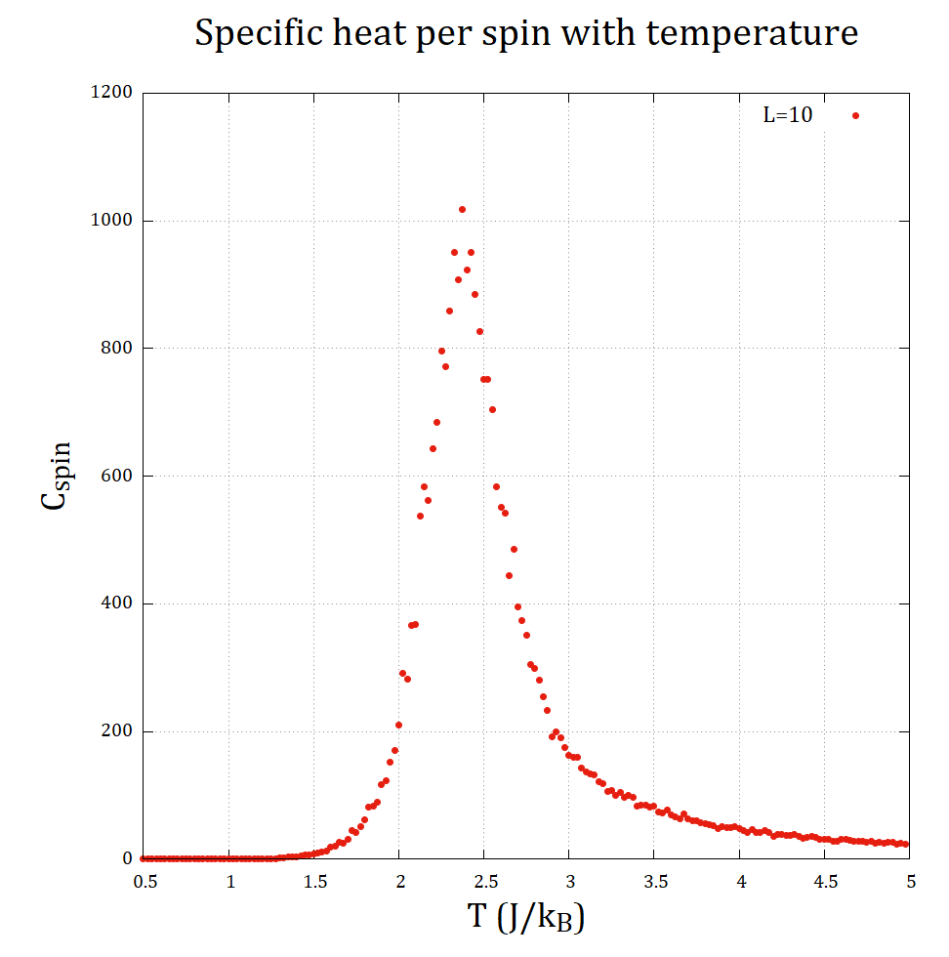
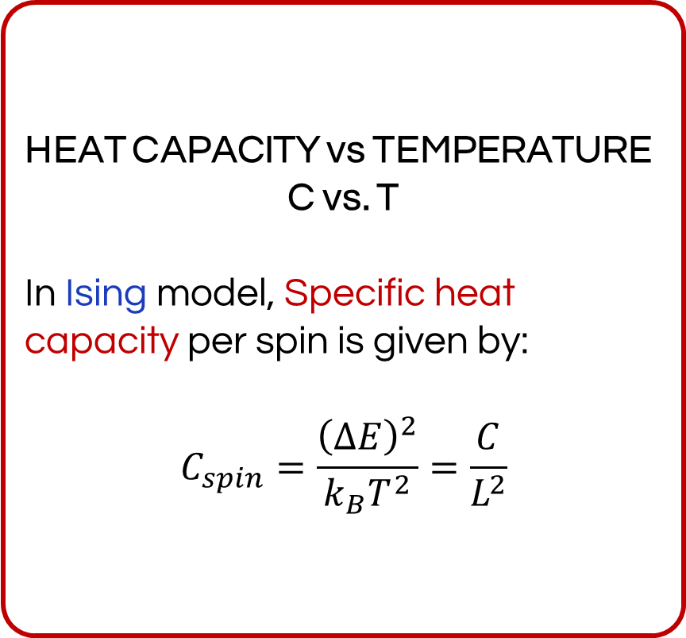
System Size and 2D Analysis
HEAT CAPACITY vs TEMPERATURE
C vs. T
In Ising model, Specific heat capacity per spin is given by:
$$C_{spin}=\frac{{\left(ΔE\right)}^{2}}{k_{B}T^{2}}=\frac{C}{L^{2}}$$

Slide 22
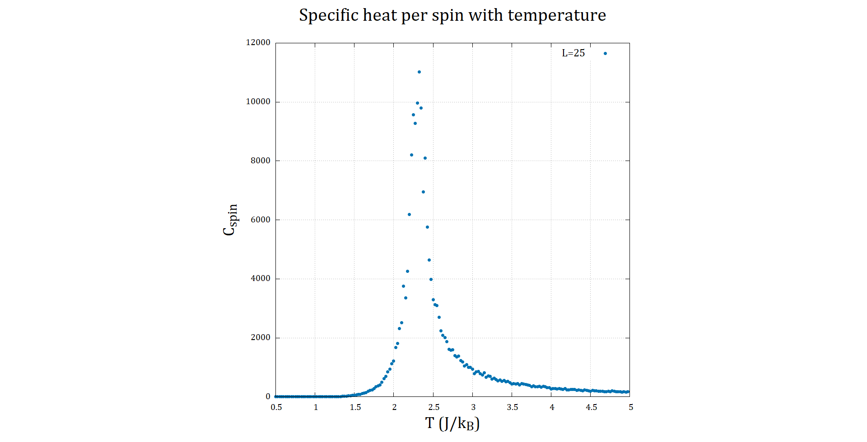
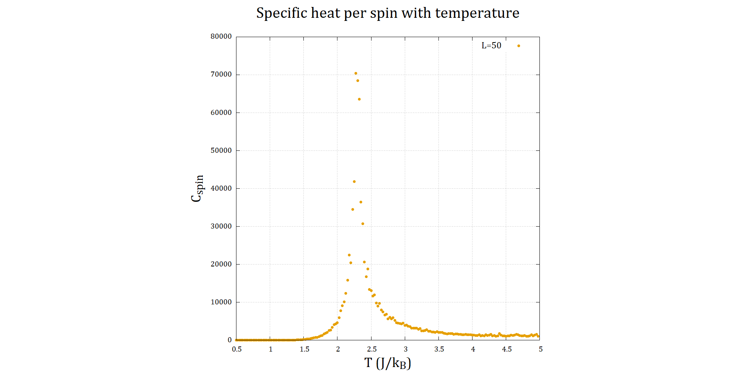
↑
↑
↑
↑
↑
16

Slide 23
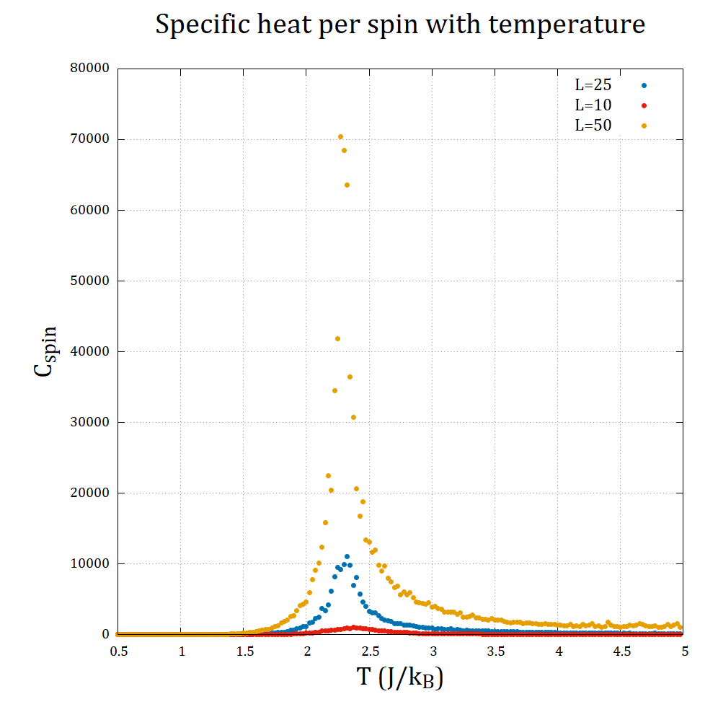
System Size and 2D Analysis
As we increase the system size (L) the specific heat capacity diverges to infinity at the Curie temperature (Tc).
And the fluctuations decreases with increasing system size (L).
↑
↑
↑
↑
↑
17

Slide 24
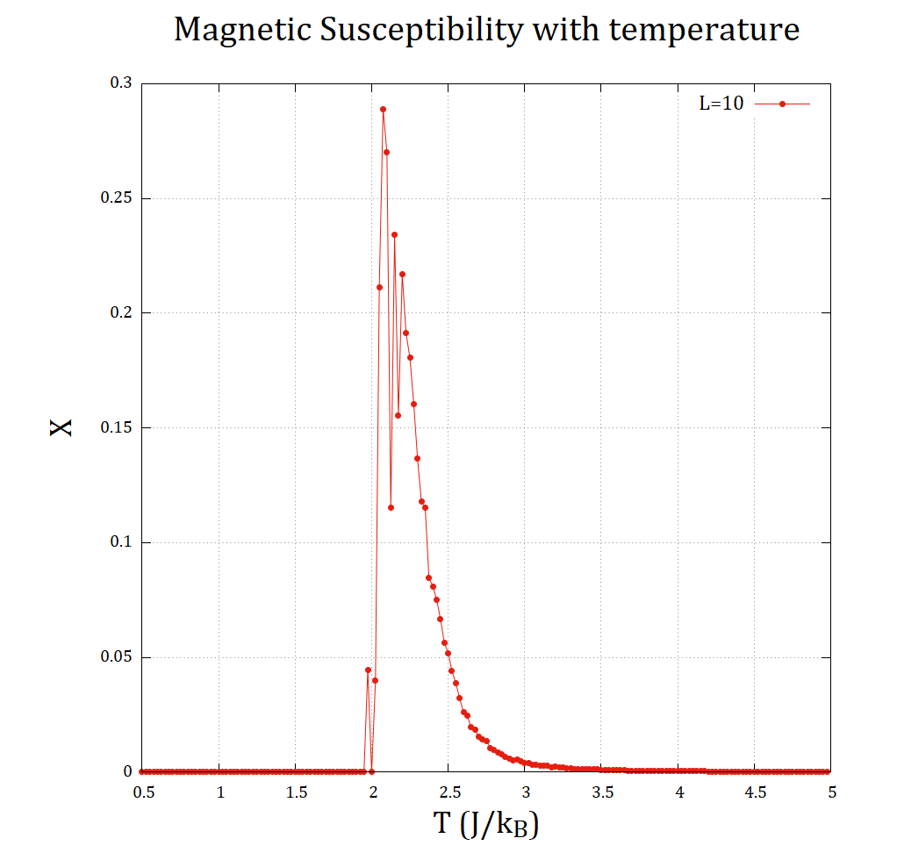
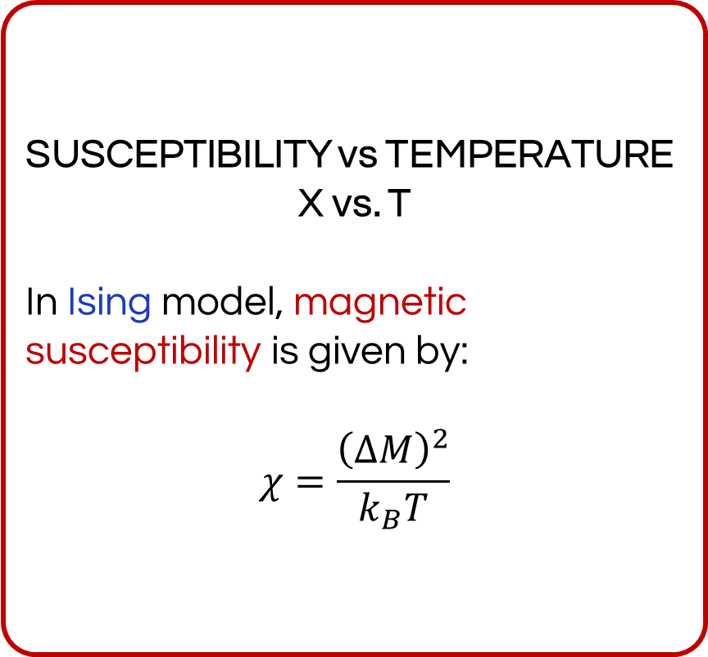
System Size and 2D Analysis
SUSCEPTIBILITY vs TEMPERATURE
X vs. T
In Ising model, magnetic susceptibility is given by:
$$χ=\frac{{\left(ΔM\right)}^{2}}{k_{B}T}$$

Slide 25
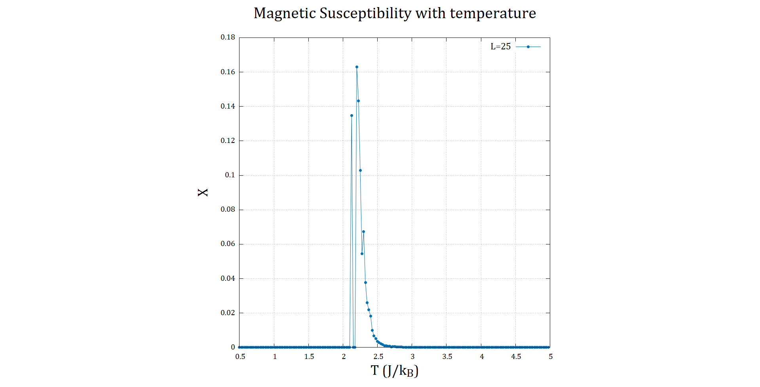
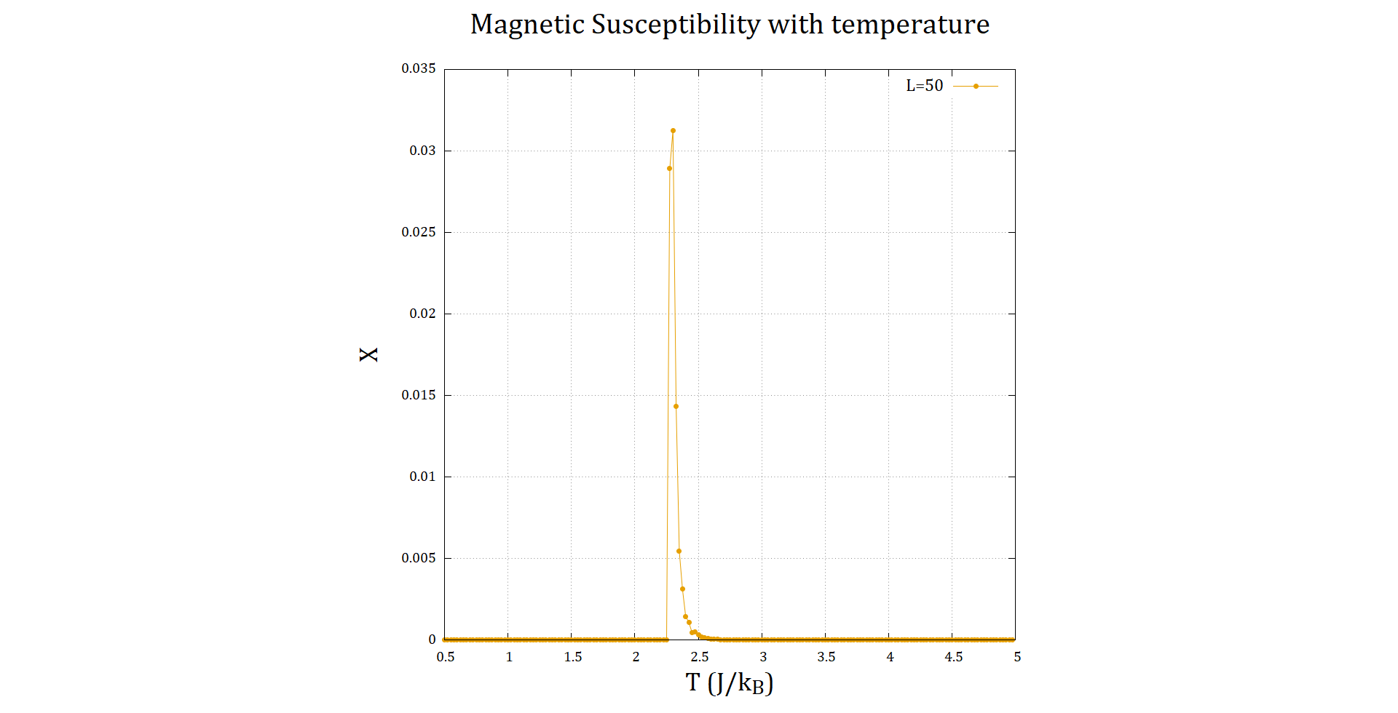
↑
↑
↑
↑
↑
18

Slide 26
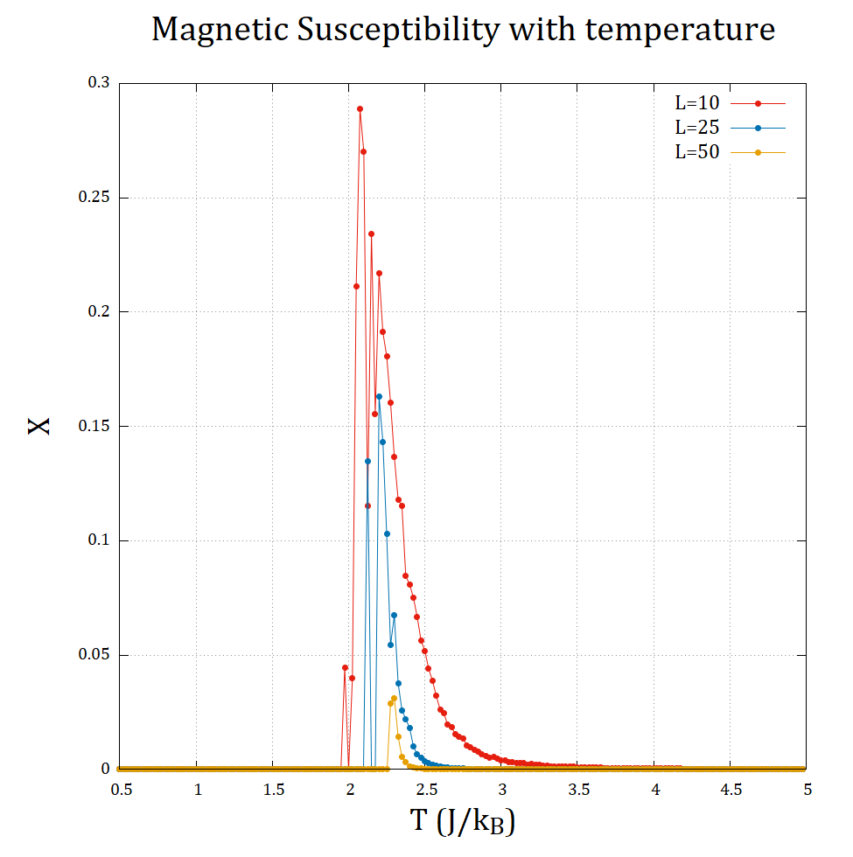
System Size and 2D Analysis
As we increase the system size (L) the magnet susceptibility diverges to infinity at the Curie temperature (Tc).
Magnet susceptibility decreases faster with increasing system size
And the fluctuations decreases with increasing system size (L).
↑
↑
↑
↑
↑
19

Slide 27
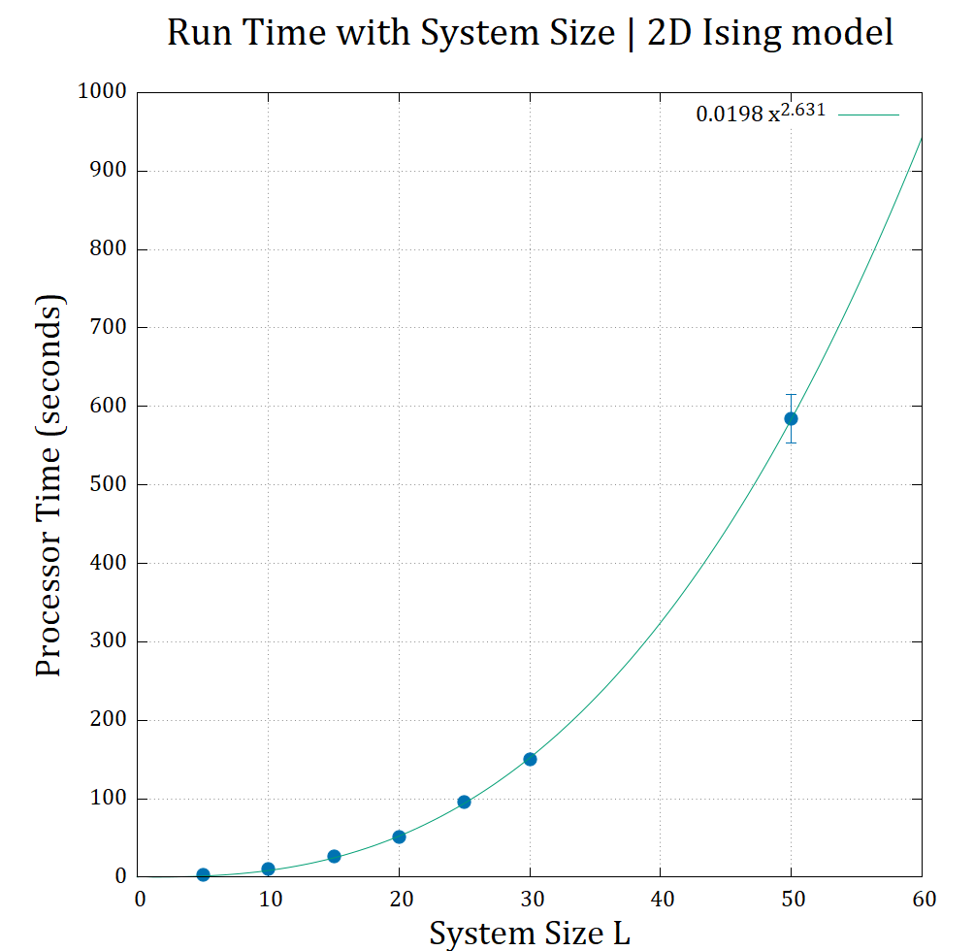
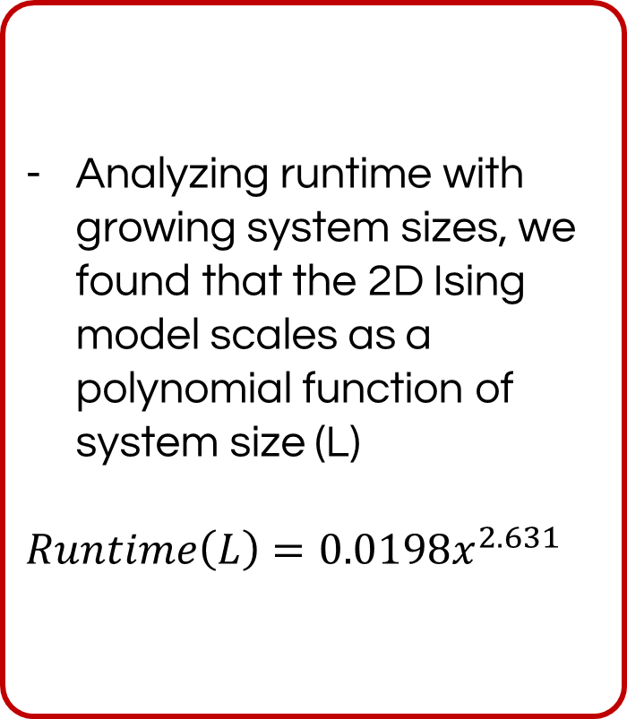
System Size and 2D Analysis
Analyzing runtime with growing system sizes, we found that the 2D Ising model scales as a polynomial function of system size (L)
$Runtime\left(L\right)=0.0198x^{2.631}$
↑
↑
↑
↑
↑
20

Slide 28
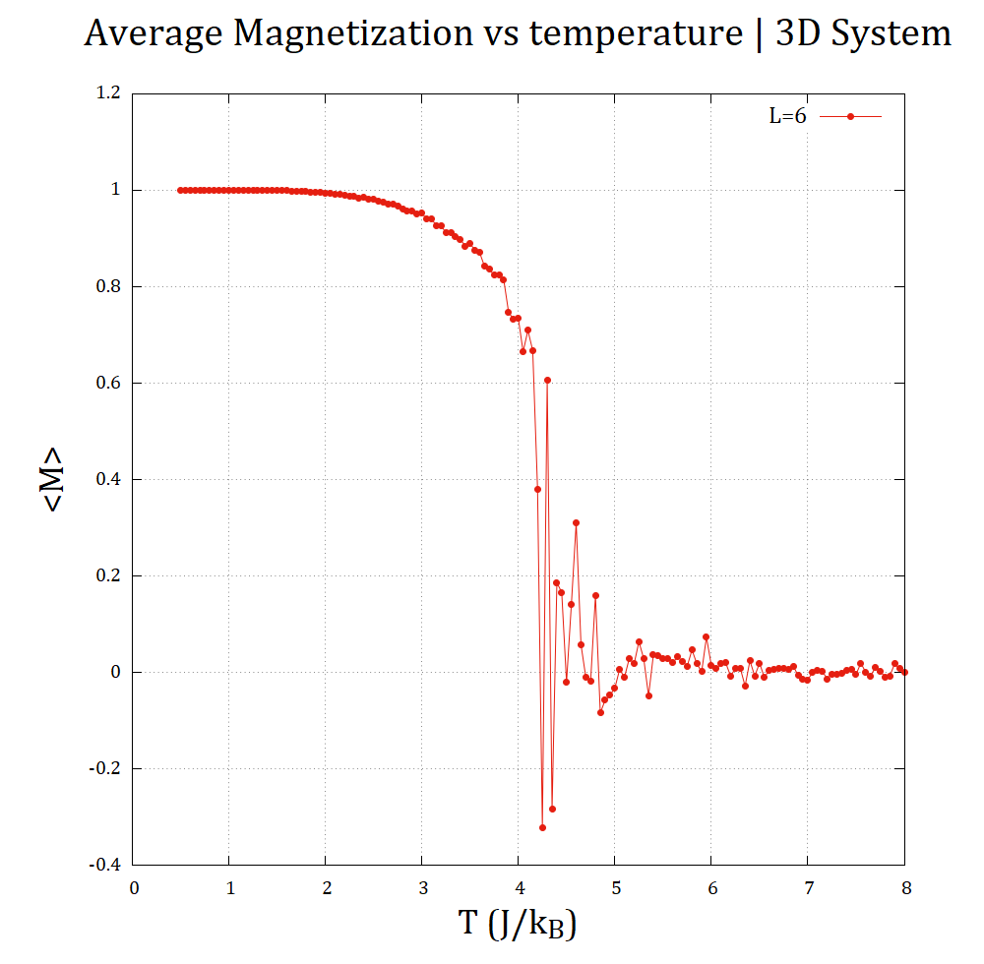
System Size and 3D Analysis
MAGNETIZATION vs TEMPERATURE
<M> vs. T
The behavior is identical to 2D.
The Curie temperature (Tc) is around 4.5 J/kB which is higher than in 2D.
Because in 3D the number of nearest neighbors is higher.

Slide 29
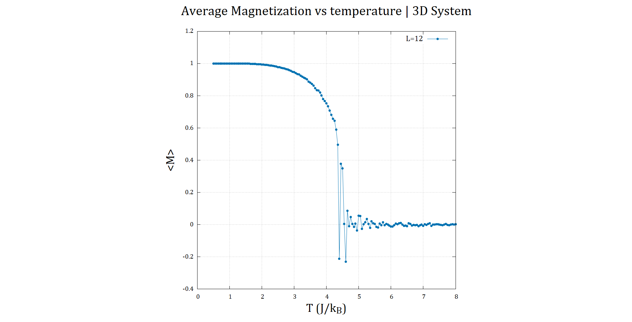
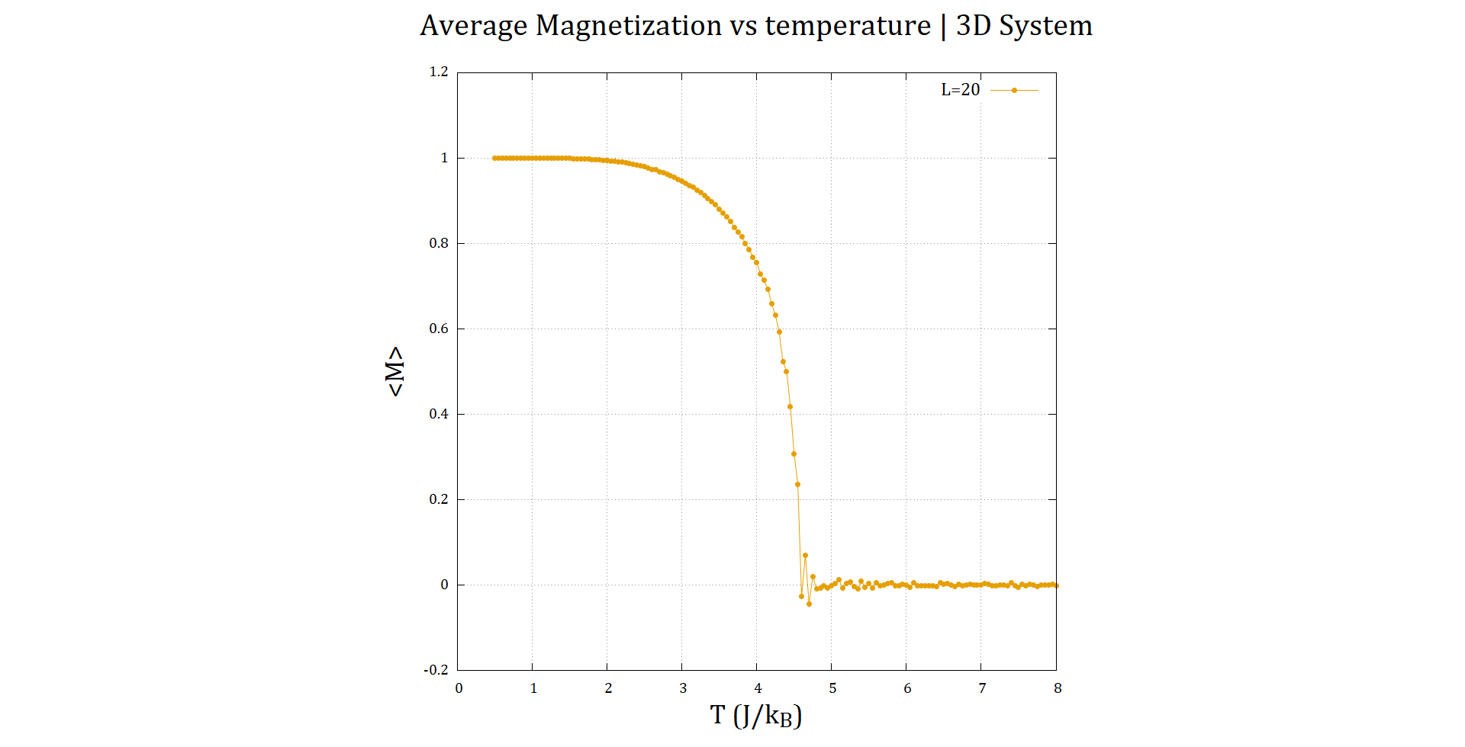
↑
↑
↑
↑
↑
21

Slide 30
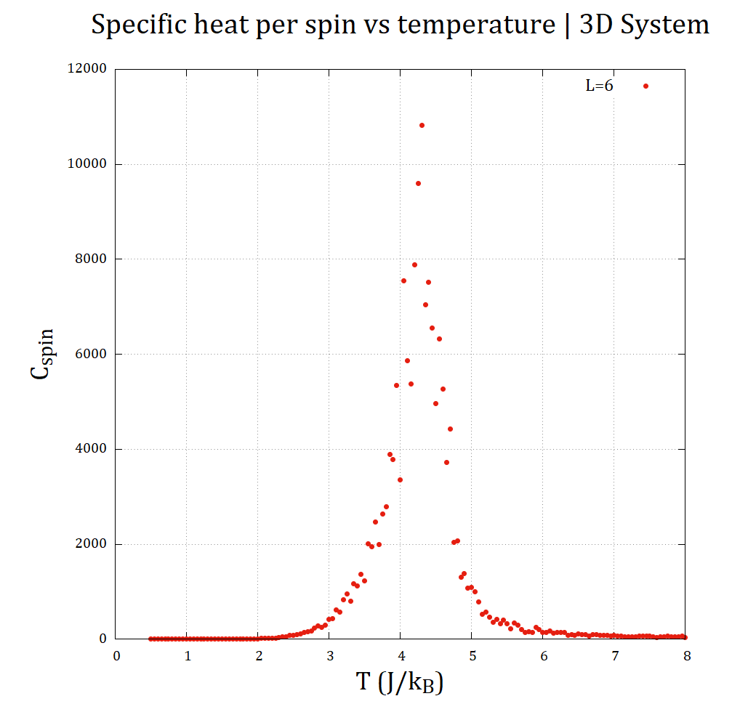
System Size and 3D Analysis
HEAT CAPACITY vs TEMPERATURE
C vs. T
The behavior is identical to 2D.
The Curie temperature (Tc) is around 4.5 J/kB which is higher than in 2D.

Slide 31
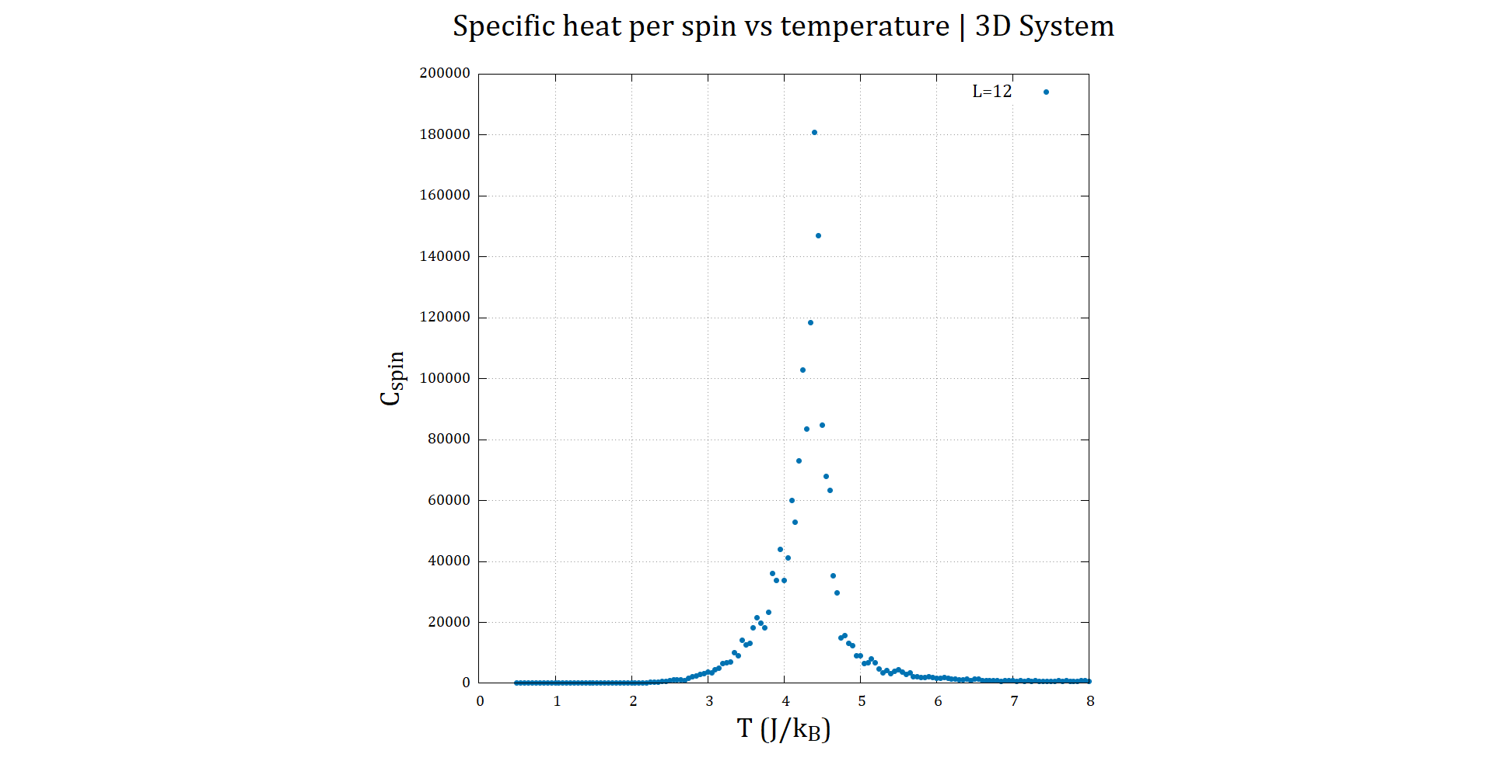
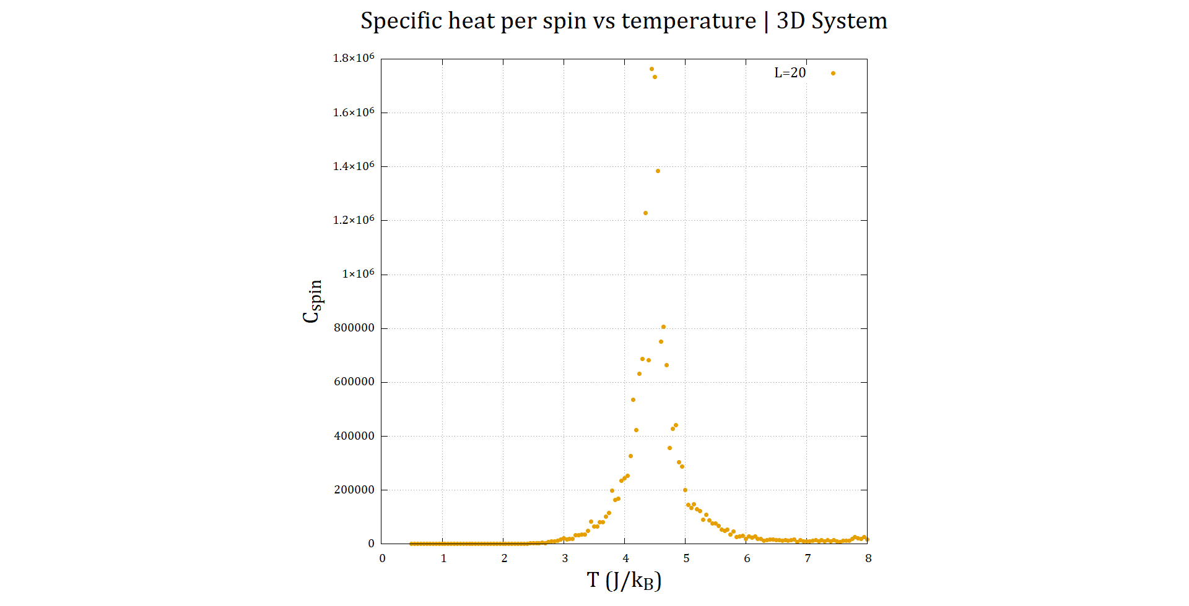
↑
↑
↑
↑
↑
22

Slide 32
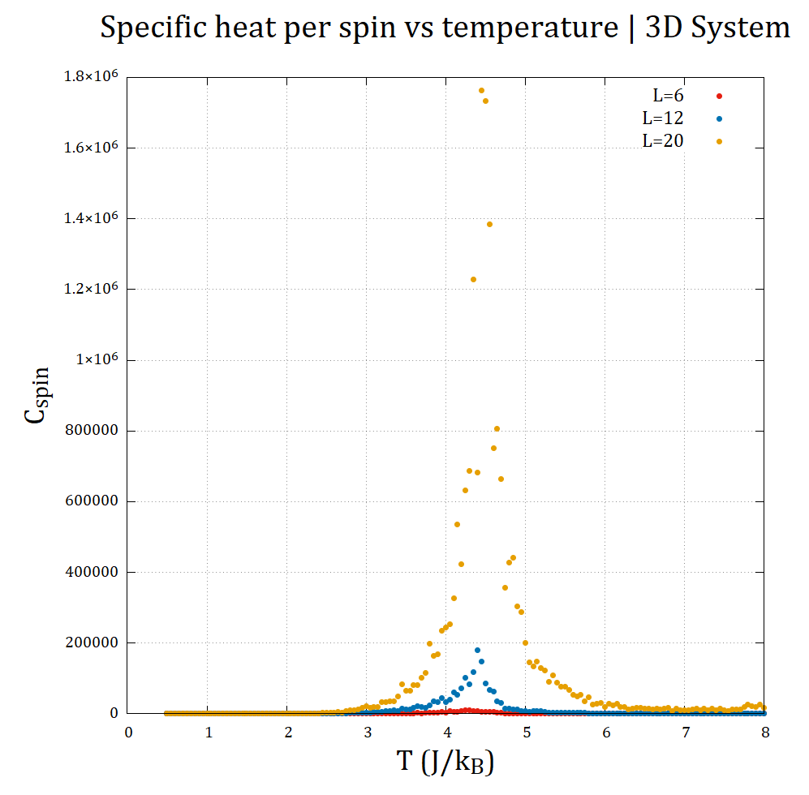
System Size and 3D Analysis
The noise is less than 2D.
↑
↑
↑
↑
↑
23

Slide 33
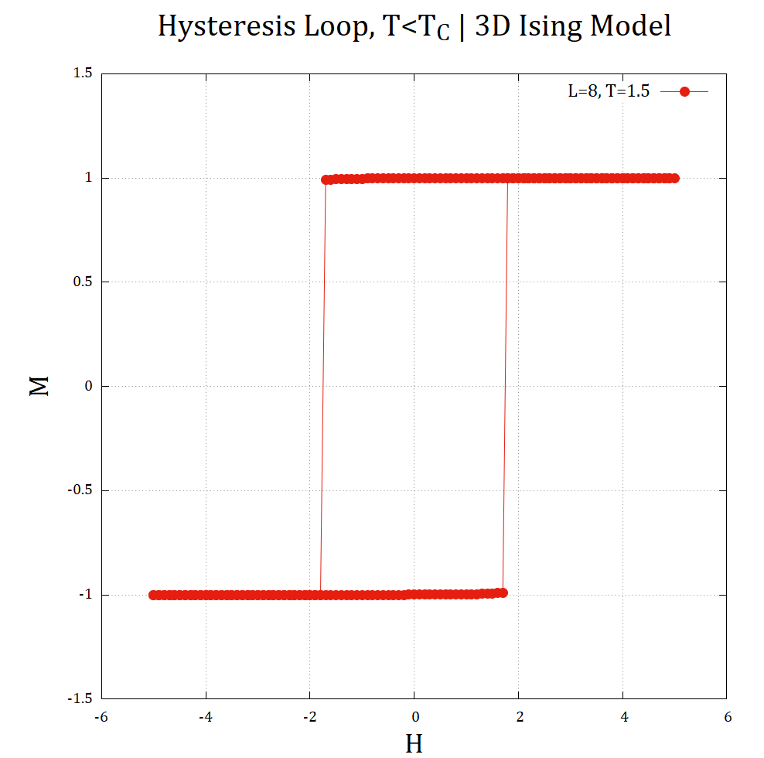
System Size and 3D Analysis
HYSTERESIS LOOP
<M> vs. B
There is hysteresis loop in 3D. The same as 2D.

Slide 34
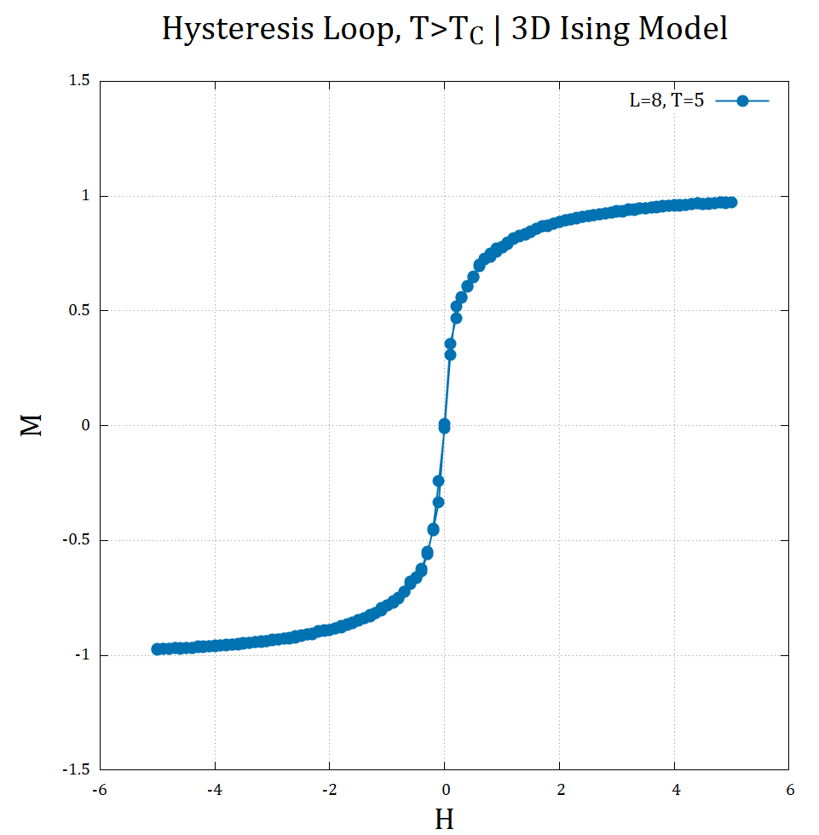
↑
↑
↑
↑
↑
24

Slide 35
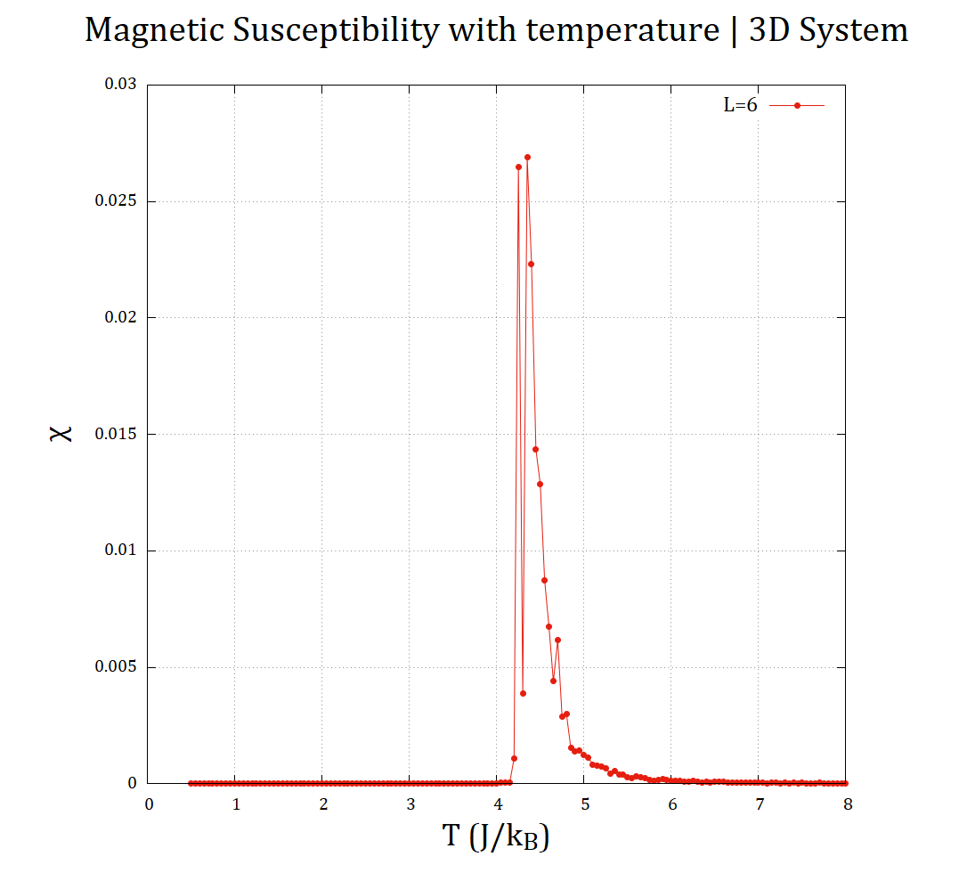
System Size and 3D Analysis
SUSCEPTIBILITY vs TEMPERATURE
X vs. T
The behavior is similar to the 2D results
The susceptibility reduces with system size, while Tc increases.

Slide 36
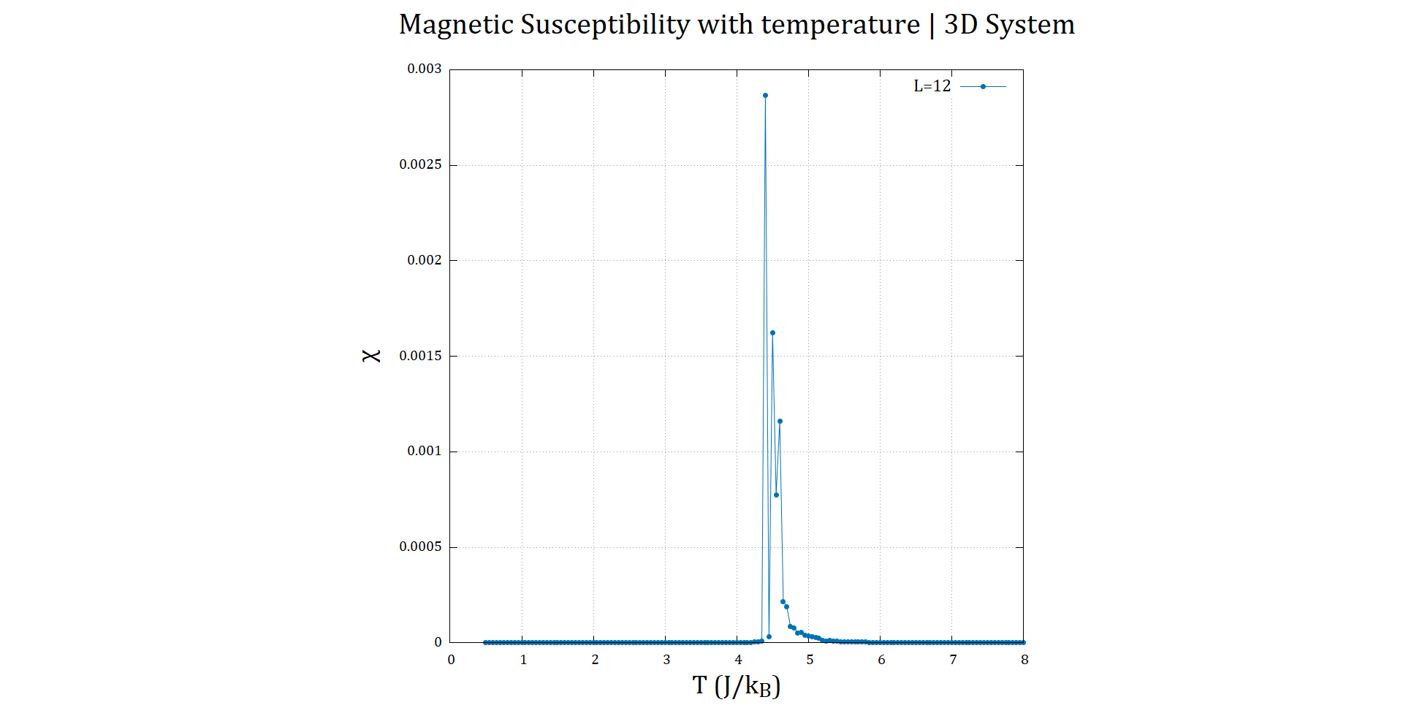
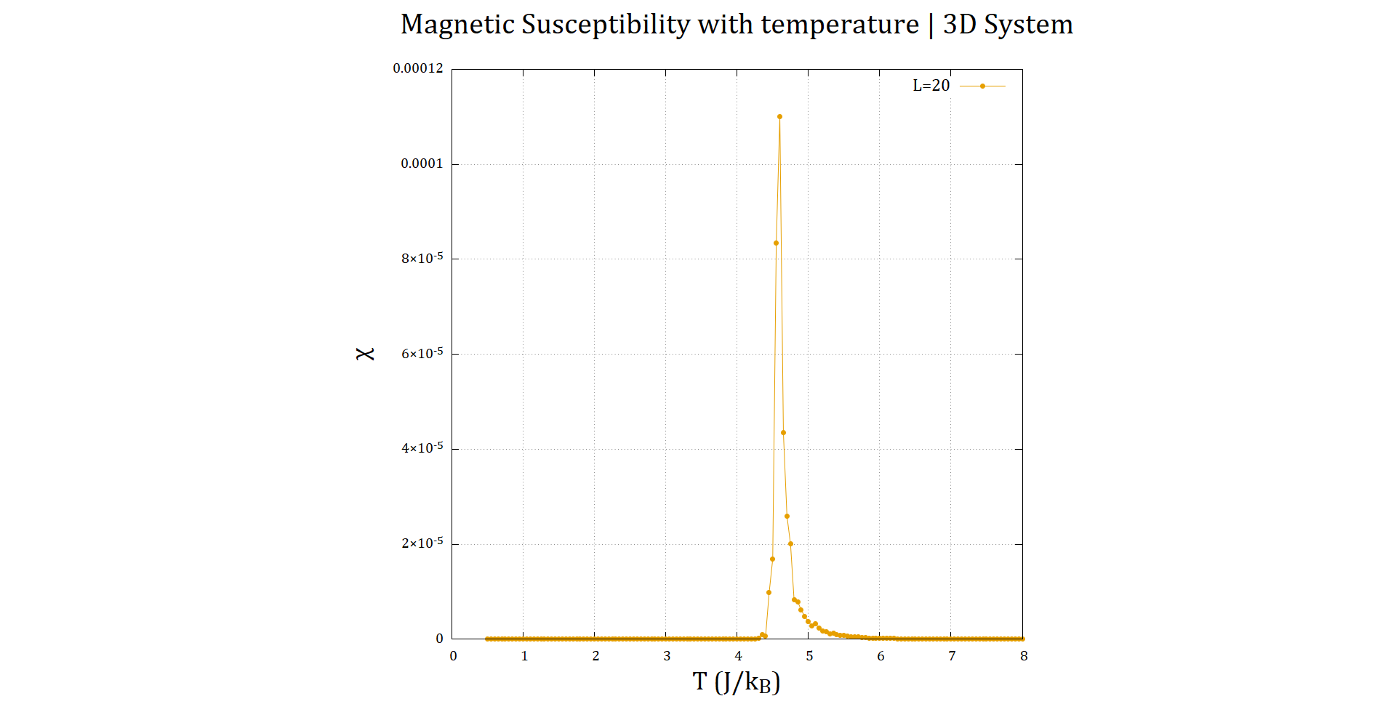
↑
↑
↑
↑
↑
25

Slide 37
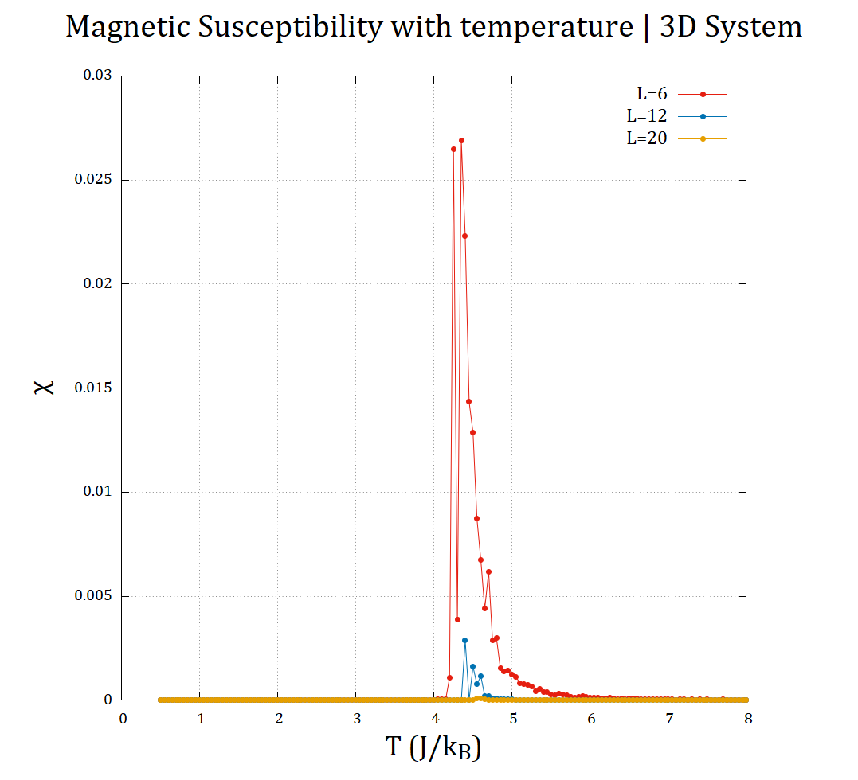
System Size and 3D Analysis
The Susceptibility decreases, while the Curie temperature increases marginally.
↑
↑
↑
↑
↑
26

Slide 38
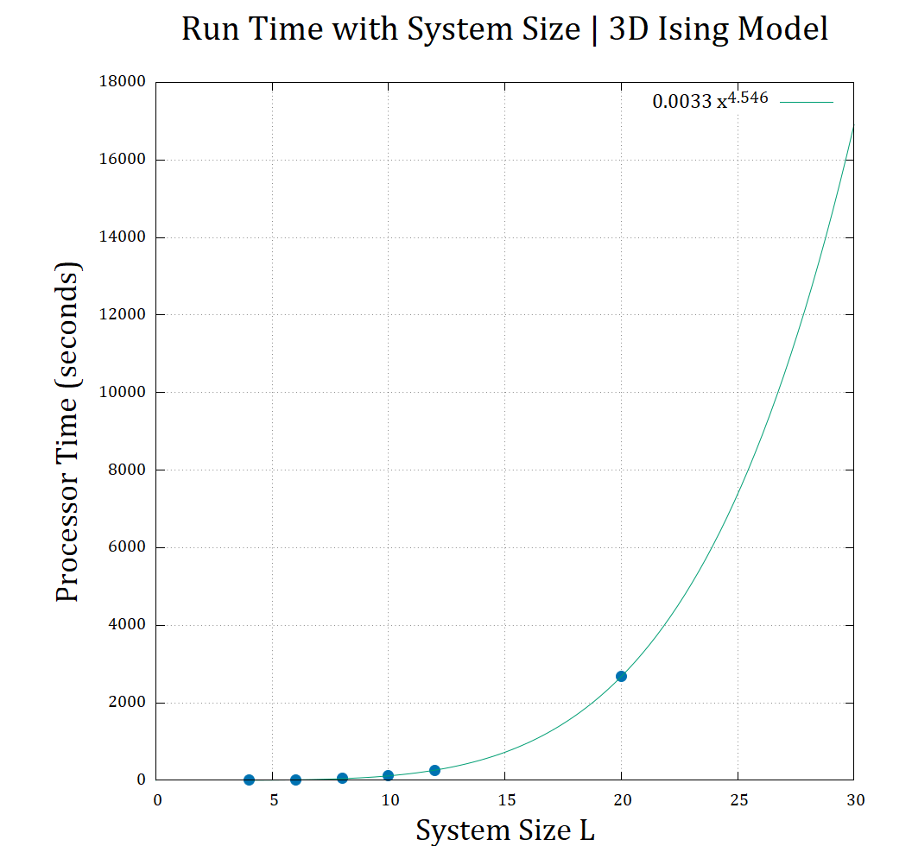
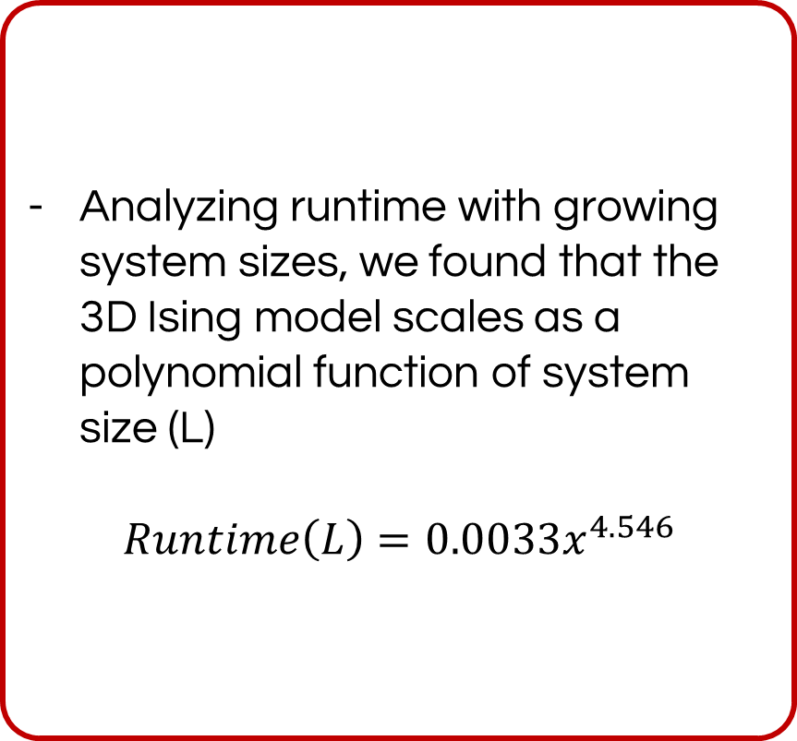
System Size and 3D Analysis
Analyzing runtime with growing system sizes, we found that the 3D Ising model scales as a polynomial function of system size (L)
$Runtime\left(L\right)=0.0033x^{4.546}$
↑
↑
↑
↑
↑
27

Slide 39


Slide 40
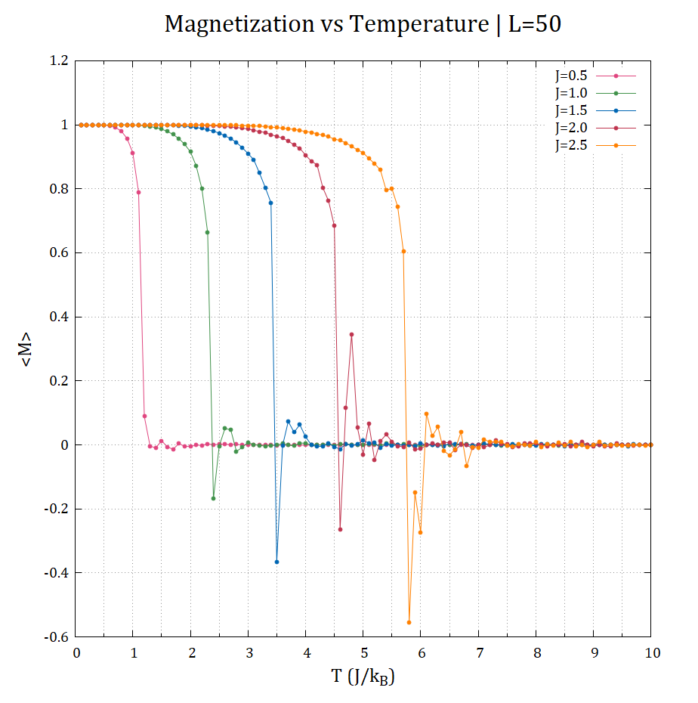
Coupling Constant Analysis
MAGNETIZATION vs TEMPERATURE
<M> vs. T
As we increases the coupling strength as the Curie temperature increases.
↑
↑
↑
↑
↑
28

Slide 41
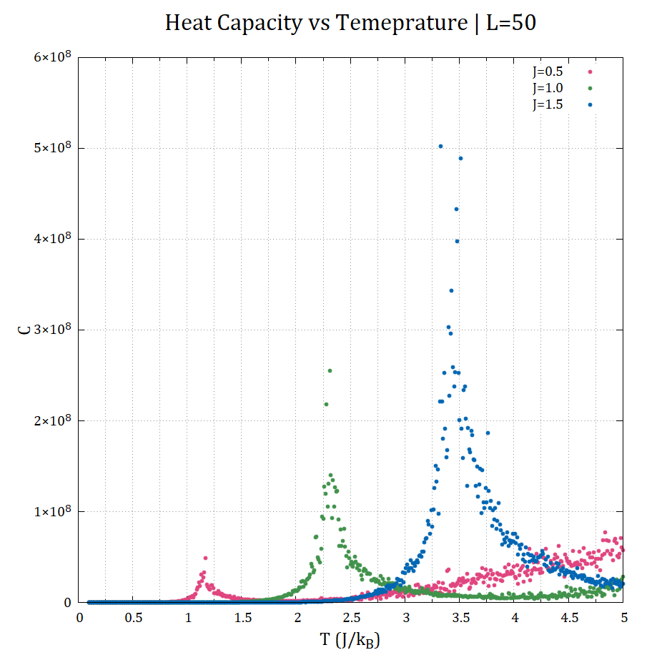
Coupling Constant Analysis
HEAT CAPACITY vs TEMPERATURE
C vs. T
The results agree with the results of magnetization vs temperature.
Which the Curie temperature increases by increasing the coupling strength.
↑
↑
↑
↑
↑
29

Slide 42
Coupling Constant Analysis
SUSCEPTIBILITY vs TEMPERATURE
X vs. T
Again, the results agreed with the previous two. You can notice that the singularity of the susceptibility shifts to the right.

Slide 43
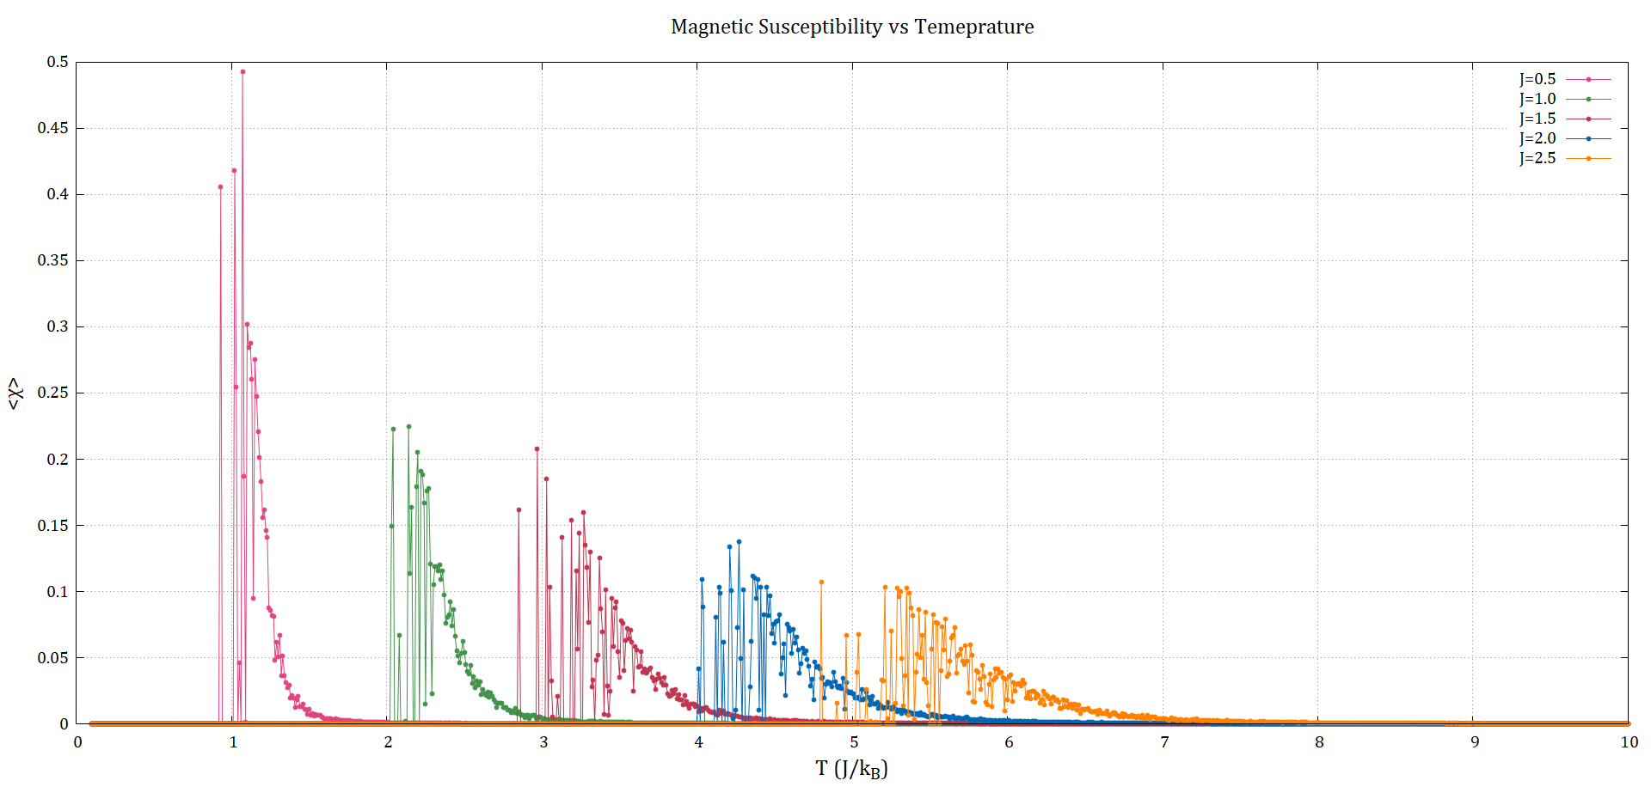
↑
↑
↑
↑
↑
30

Slide 44
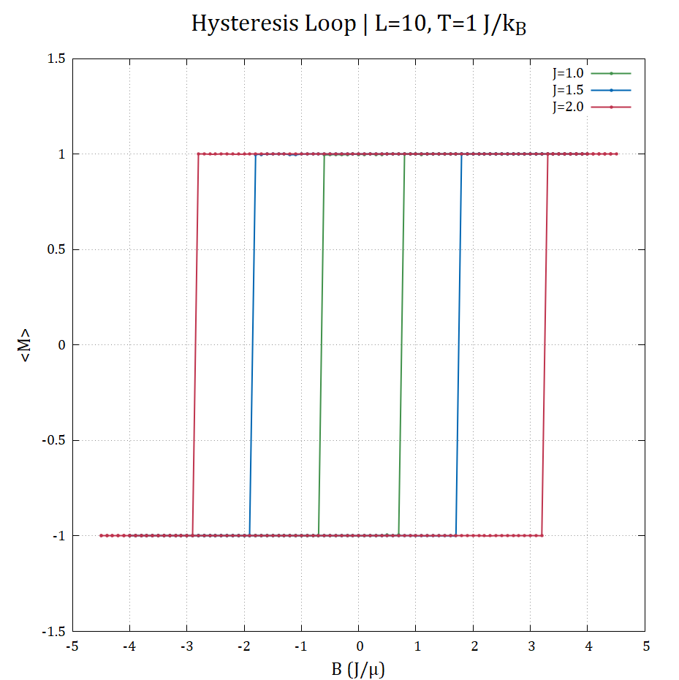
Coupling Constant Analysis
HYSTERESIS LOOP
<M> vs. B
As the coupling constant increases, as the material becomes more ferromagnetic, that means it’s highly magnetized. So, the coercive field is higher for higher coupling constant.
↑
↑
↑
↑
↑
31

Slide 45
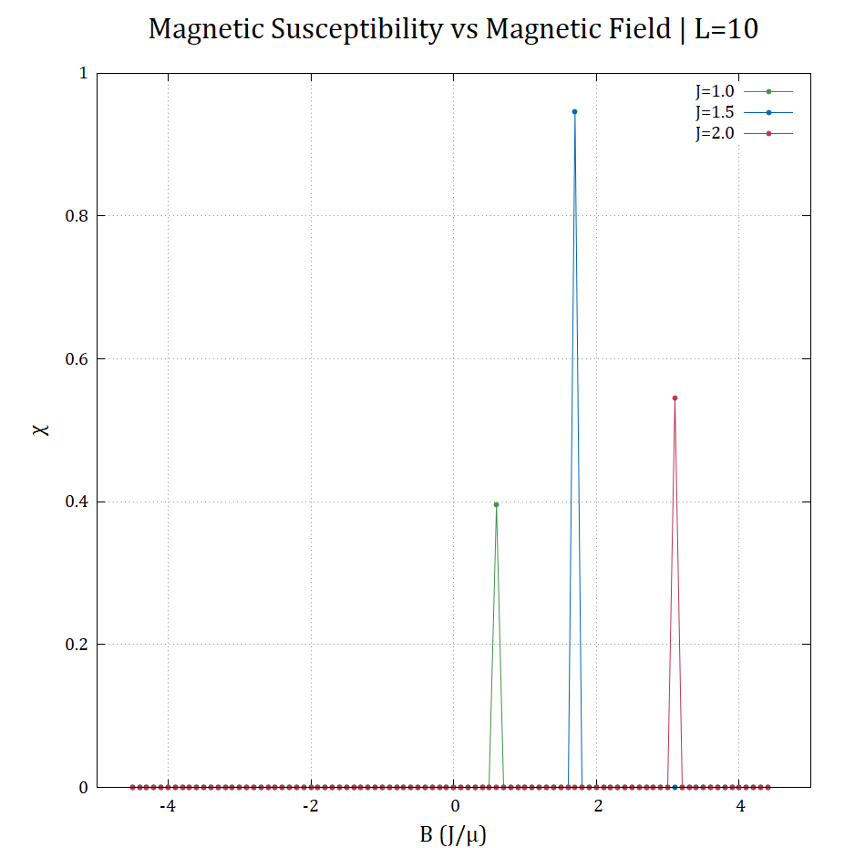
Coupling Constant Analysis
SUSCEPTIBILITY vs MAGNETIC FIELD
X vs. B
These results agrees with the previous, because the maxima of susceptibility represents the coercive field. Which is increasing with coupling strength.
↑
↑
↑
↑
↑
32

Slide 46


Coupling Constant Analysis
COERCIVE FIELD vs COUPLING CON.
Bc vs. J
Fitting the behavior of coercive field with the coupling strength. Which is found to be linear by this equation:
$$B_{c}=3.21x−3$$
↑
↑
↑
↑
↑
33

Slide 47

Anti-ferromagnetism
MAGNETIZATION vs TEMPERATURE
<M> vs. T
Trying to find the Neel temperature or phase transition of antiferromagnetic material by studying M vs. T.
Which is NOT useful, because the average of magnetization is zero in both antiferro- and para- regions.
↑
↑
↑
↑
↑
34

Slide 48


Anti-ferromagnetism
SUSCEPTIBILITY vs TEMPERATURE
$χ$ vs. T
Finding Néel temperature by studying susceptibility with temperature.
Here, the Néel temperature at the maxima of susceptibility.

Slide 49


↑
↑
↑
↑
↑
35

Slide 50

Anti-ferromagnetism
FINDING NÉEL TEMPERATURE
By fitting 1/X vs. T with a linear equation, during to Curie-Weiss law. Note that Curie-Weiss law is derived from mean field, so this is just an estimate.

Slide 51


↑
↑
↑
↑
↑
36

Slide 52

Arbitrary Spin Direction in 2D
PHASE TRANSITION
Ferro to Para by Increasing Temp.
This animation shows the spins of the system in the transition from ferro- to para- magnetism by increasing temperature.
↑
↑
↑
↑
↑
37

Slide 53

Arbitrary Spin Direction in 2D
HYSTERESIS LOOP
<M> vs. B
Visualizing the hysteresis loop by showing the spins as the magnetic field changes.
Try to find the coercive field!
↑
↑
↑
↑
↑
38

Slide 54
FUTURE WORK
Apply parallelization to run systems larger
↑
Try other algorithms than Monte Carlo
Metropolis, like Wolff algorithm
↑
↑
Consider other term on Hamiltonian
↑
Calculate the critical exponents of Ising model
↑
Study universality, scale invariance of Ising model
39

Slide 55
SUMMARY
2D and 3D Ising models were simulated
↑
Effects of system size were studied
↑
General spin direction was implemented
↑
The effect of coupling strength is studied
↑
Anti-ferromagnetism was studied using Ising model
↑
40

Slide 56
WORK DISTRIBUTION
↑
Kumail
Asif
↑
Almost Everything
Code – Presentation – Researches
Making memes – Waiting centuries
for codes to finish running
↑
↑
↑
41

Slide 57

THANK YOU

